Slide 1
Everything You Ever Wanted To Know About Policy (and then some) But Didn’t Know Who To Ask
Peggy Holstedt, Director
Policy Services

Slide 2
“School Board policies are statements which set forth the purpose and prescribe in general terms the organization and program of a school system.”
National School Boards Association
Notes:
Jaksmata, http://creativecommons.org/licenses/by-sa/3.0/legalcode, https://en.wikipedia.org/wiki/Framing_(construction)#/media/File:Wood-framed_house.jpg

Slide 3
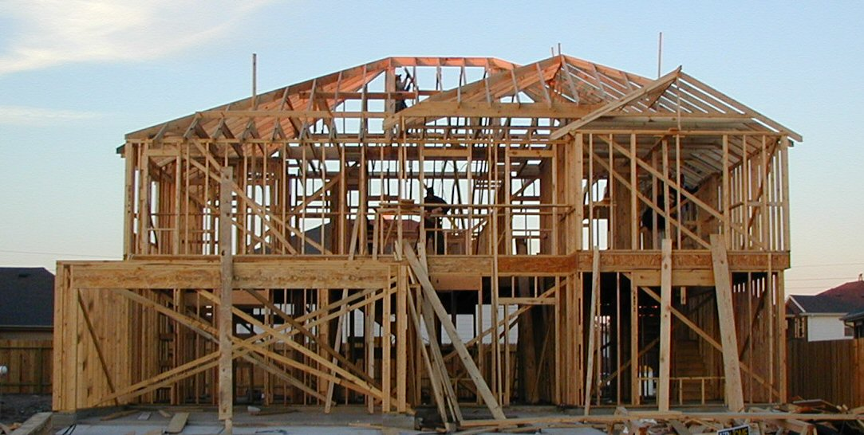
“They create a framework within which the superintendent and his/her staff can discharge their assigned duties with positive direction.”
National School Boards Association
Notes:
Jaksmata, http://creativecommons.org/licenses/by-sa/3.0/legalcode, https://en.wikipedia.org/wiki/Framing_(construction)#/media/File:Wood-framed_house.jpg

Slide 4
WHAT
“They tell
is wanted.”
National School Boards Association

Slide 5
WHAT
&WHY

Slide 6
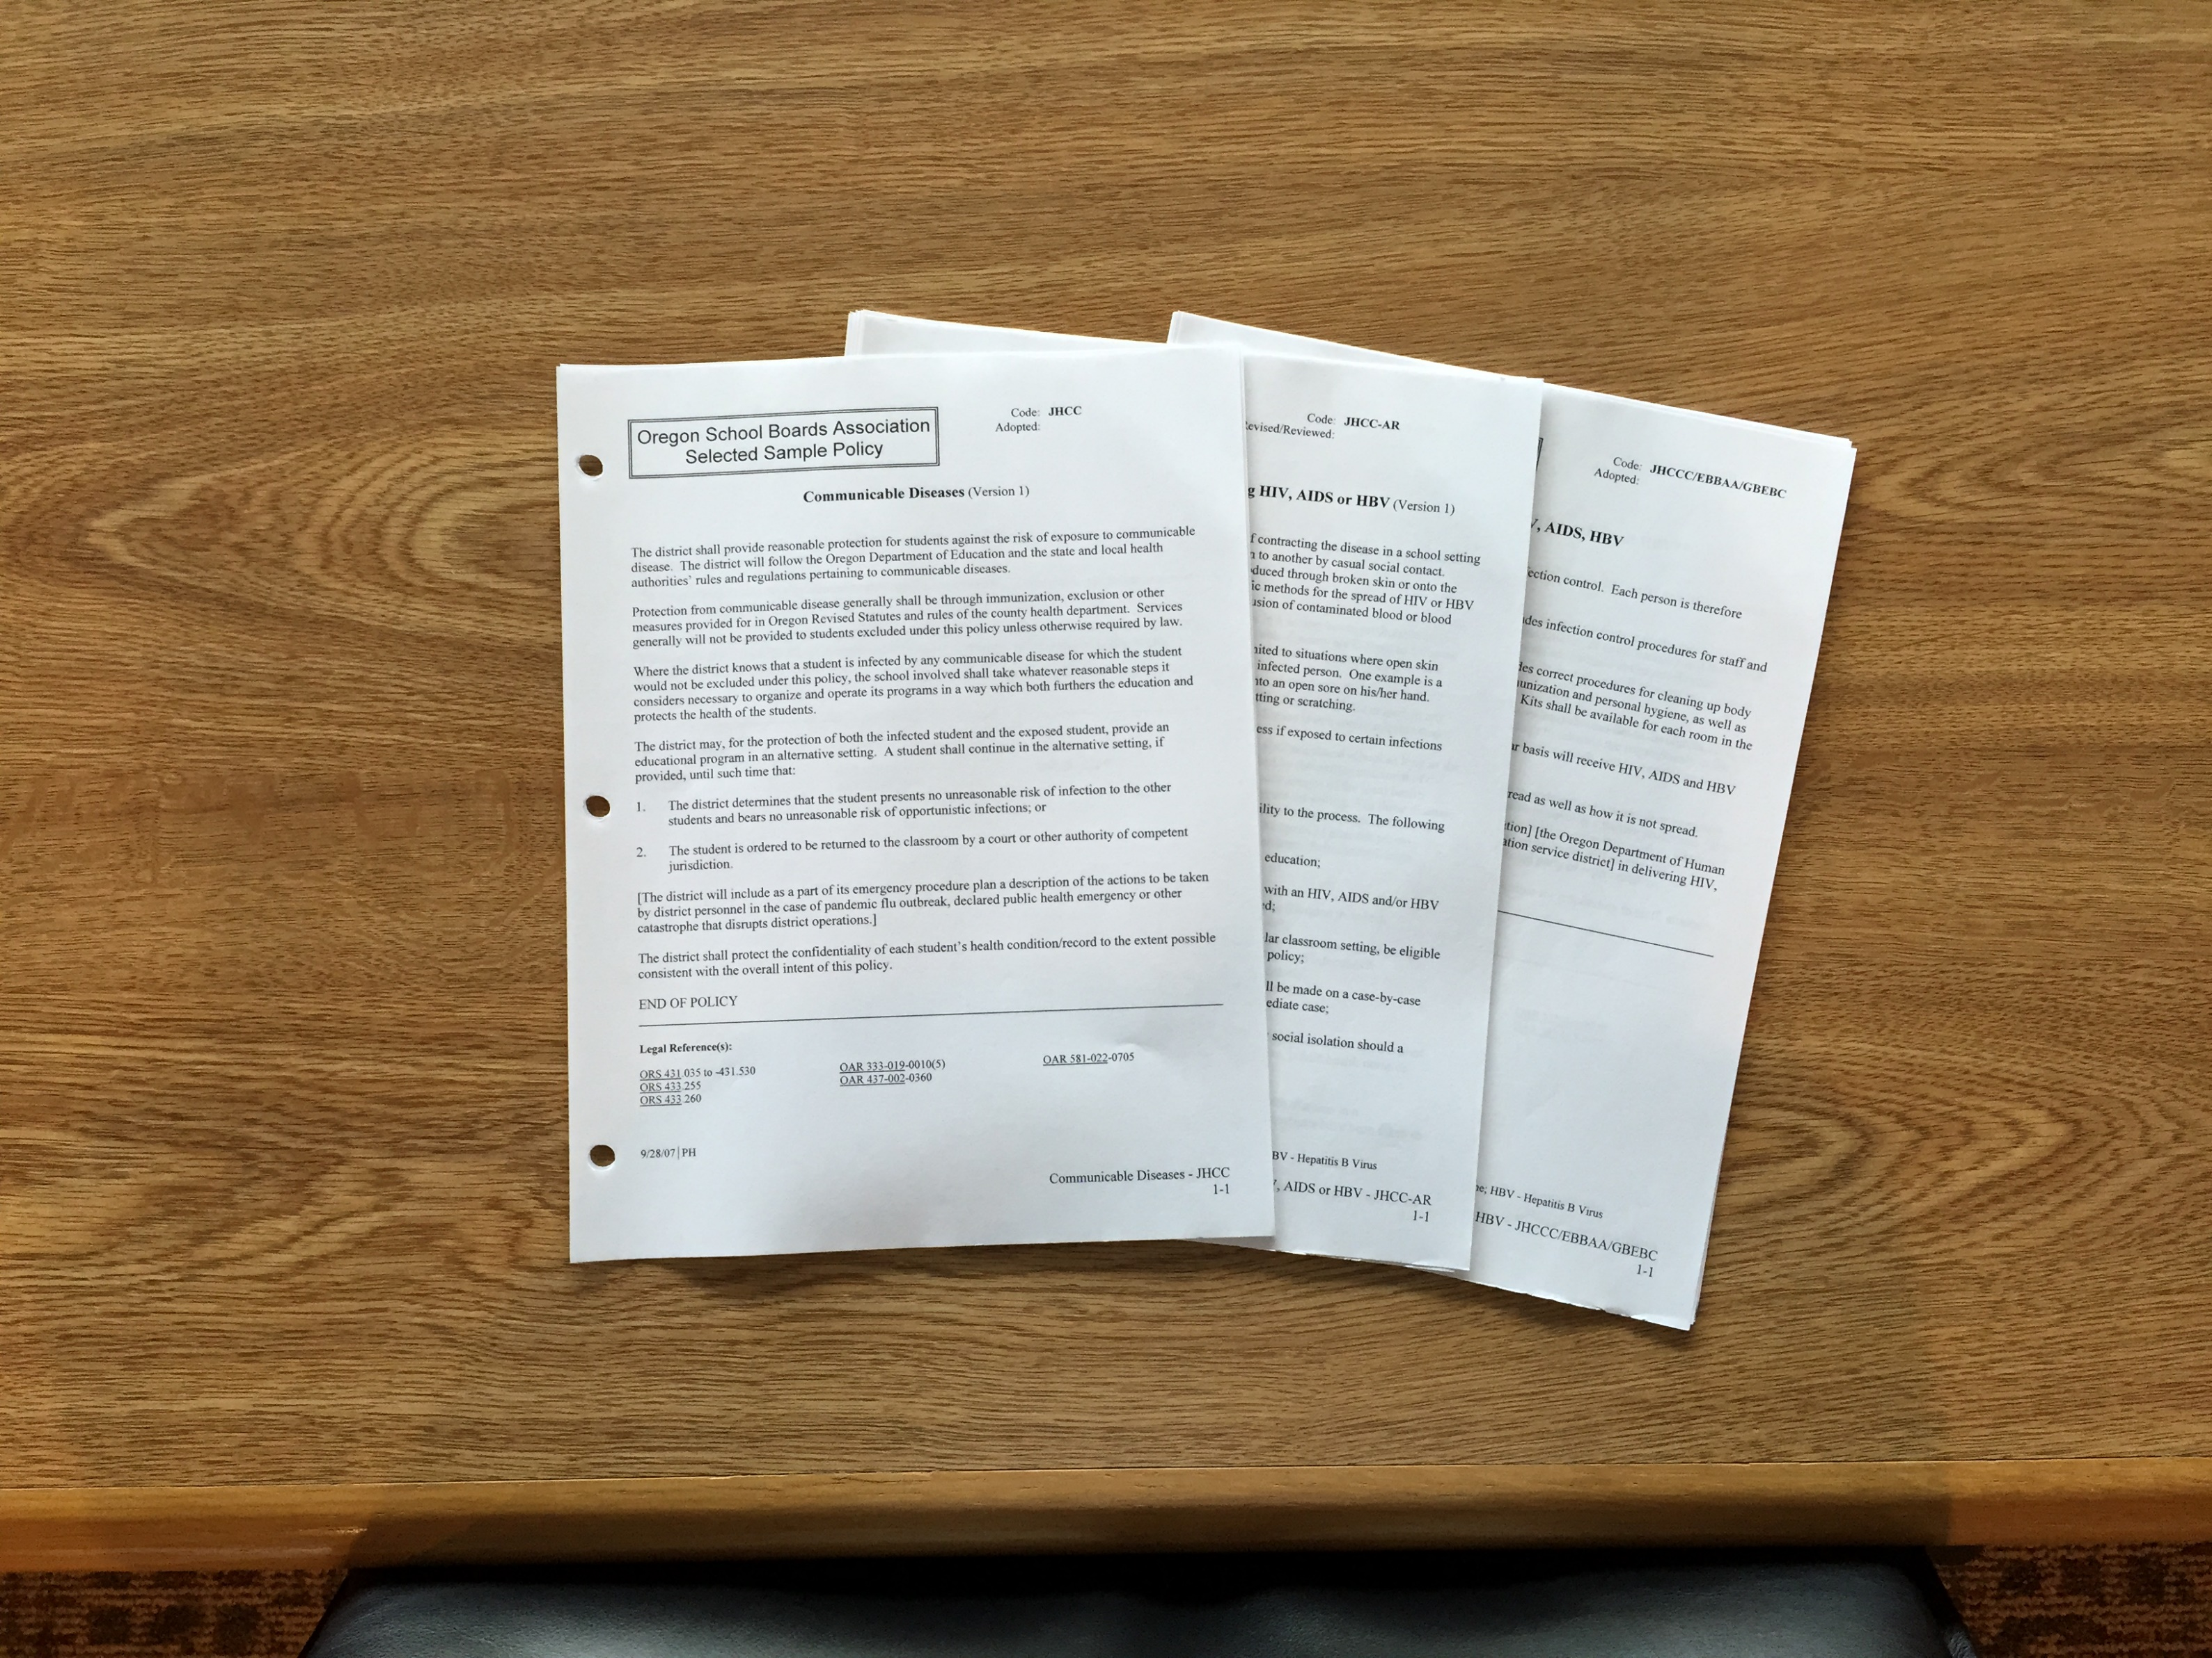
Specific for clear guidance
Broad for administrative discretion

Slide 7
Specific for clear guidance
Broad for administrative discretion

Slide 8
DETAILED DIRECTIONS
FORMS
JOB DESCRIPTIONS

Slide 9
POLICY
WHAT
WHY

Slide 10
POLICY
AR
WHO
HOW WHEN WHERE
WHAT
WHY

Slide 11
 | Policy | AR
Developed By | Board | Administration
Board Action | Adoption | Review, some must be adopted
Language | Broad language that gives the direction to the administration. | Specific language that implements the direction from the policy. Detailed Direction.
 | WHAT, WHY. The end result. | HOW, WHO, WHEN, WHERE. The means to get to the end result.

Slide 12
If not Policy or AR where else could it be?

Slide 13
POLICY
AR
HANDBOOKS
INTERNAL PROCEDURES
PLANS
WHO
HOW WHEN WHERE
WHAT
WHY

Slide 14
POLICY
AR
HANDBOOKS
INTERNAL PROCEDURES
PLANS
WHO
HOW WHEN WHERE
WHAT
WHY

Slide 15
POLICY
AR
HANDBOOKS
INTERNAL PROCEDURES
PLANS
WHO
HOW WHEN WHERE
WHAT
WHY

Slide 16
Contract

Slide 17
Remember!
Policies are legal documents, not a Nobel prize in literature
Phrases and words have legal meaning which may not create the perfect sentence -- be careful of word-smithing
Policy is legally binding and creates legal liability

Slide 18
Not everything that is required is required to be in policy.
(but somethings are)

Slide 19
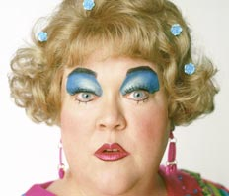
(sometimes less is more)
Notes:
Revelife.com, bing search, screen shot saved in folder

Slide 20
R6/01/10 | PH

Slide 21
REQUIRED
R6/01/10 | PH

Slide 22
REQUIRED TO DO
R6/01/10 | PH

Slide 23
REQUIRED TO DO
TO BE IN POLICY
R6/01/10 | PH

Slide 24
“Each school district board shall adopt policies that …”
Notes:
Denitza Tchacarova, http://creativecommons.org/licenses/by-sa/2.0/legalcode, https://en.wikipedia.org/wiki/Epidemiology_of_domestic_violence#/media/File:A_Russian_poster_urging_open_your_eyes_-_against_women_being_abused.jpg

Slide 25
Date of our last revision
R6/01/10 | PH

Slide 26
Primary staff member on edits
R6/01/10 | PH

Slide 27
Required
Policy EEA- Student Transportation Services
Policy EEAC- School Bus Safety Program
Policy EEACC- Student Conduct on School Buses
Policy EEACC- AR Discipline Procedures for District- Approved Student Transportation
Policy EEACD- Use of District Activity Vehicles for Student Transportation

Slide 28
HR6/01/10 | RS

Slide 29
HIGHLY RECOMMENDED
HR6/01/10 | RS

Slide 30
HIGHLY RECOMMENDED
REQUIRED TO DO
HIGHLY LITIGIOUS
HR6/01/10 | RS

Slide 31
HIGHLY RECOMMENDED
REQUIRED TO DO
HIGHLY LITIGIOUS
HR6/01/10 | RS

Slide 32
Highly Recommended
Policy EEACA- School Bus Driver Examination and Training
Policy EEACE- Loading and Unloading
Policy EEAE- Student Transportation in Private Vehicles
Policy EEBB- Use of a Private Vehicle for District Business

Slide 33
CONDITIONALLY REQUIRED
CR6/01/10 | SL

Slide 34
Conditionally Required
Policy GBEDA - Drug and Alcohol Testing- Transportation Personnel
Policy GBEDA-AR Drug and Alcohol Testing- Transportation Personnel
*Required only if district operates their own transportation services or any district staff that is required to have a CDL)

Slide 35
OPTIONAL
6/01/10 | PH

Slide 36
Optional
Policy EEAB- School Bus Scheduling and Routing
Policy EEACCA- Video Cameras on Transportation Vehicles
Policy EEACCA-AR Video Cameras on Transportation Vehicles
Policy EEAD- Special Use of School Buses ( applies only to those districts that have their own transportation and not contracted out)

Slide 37
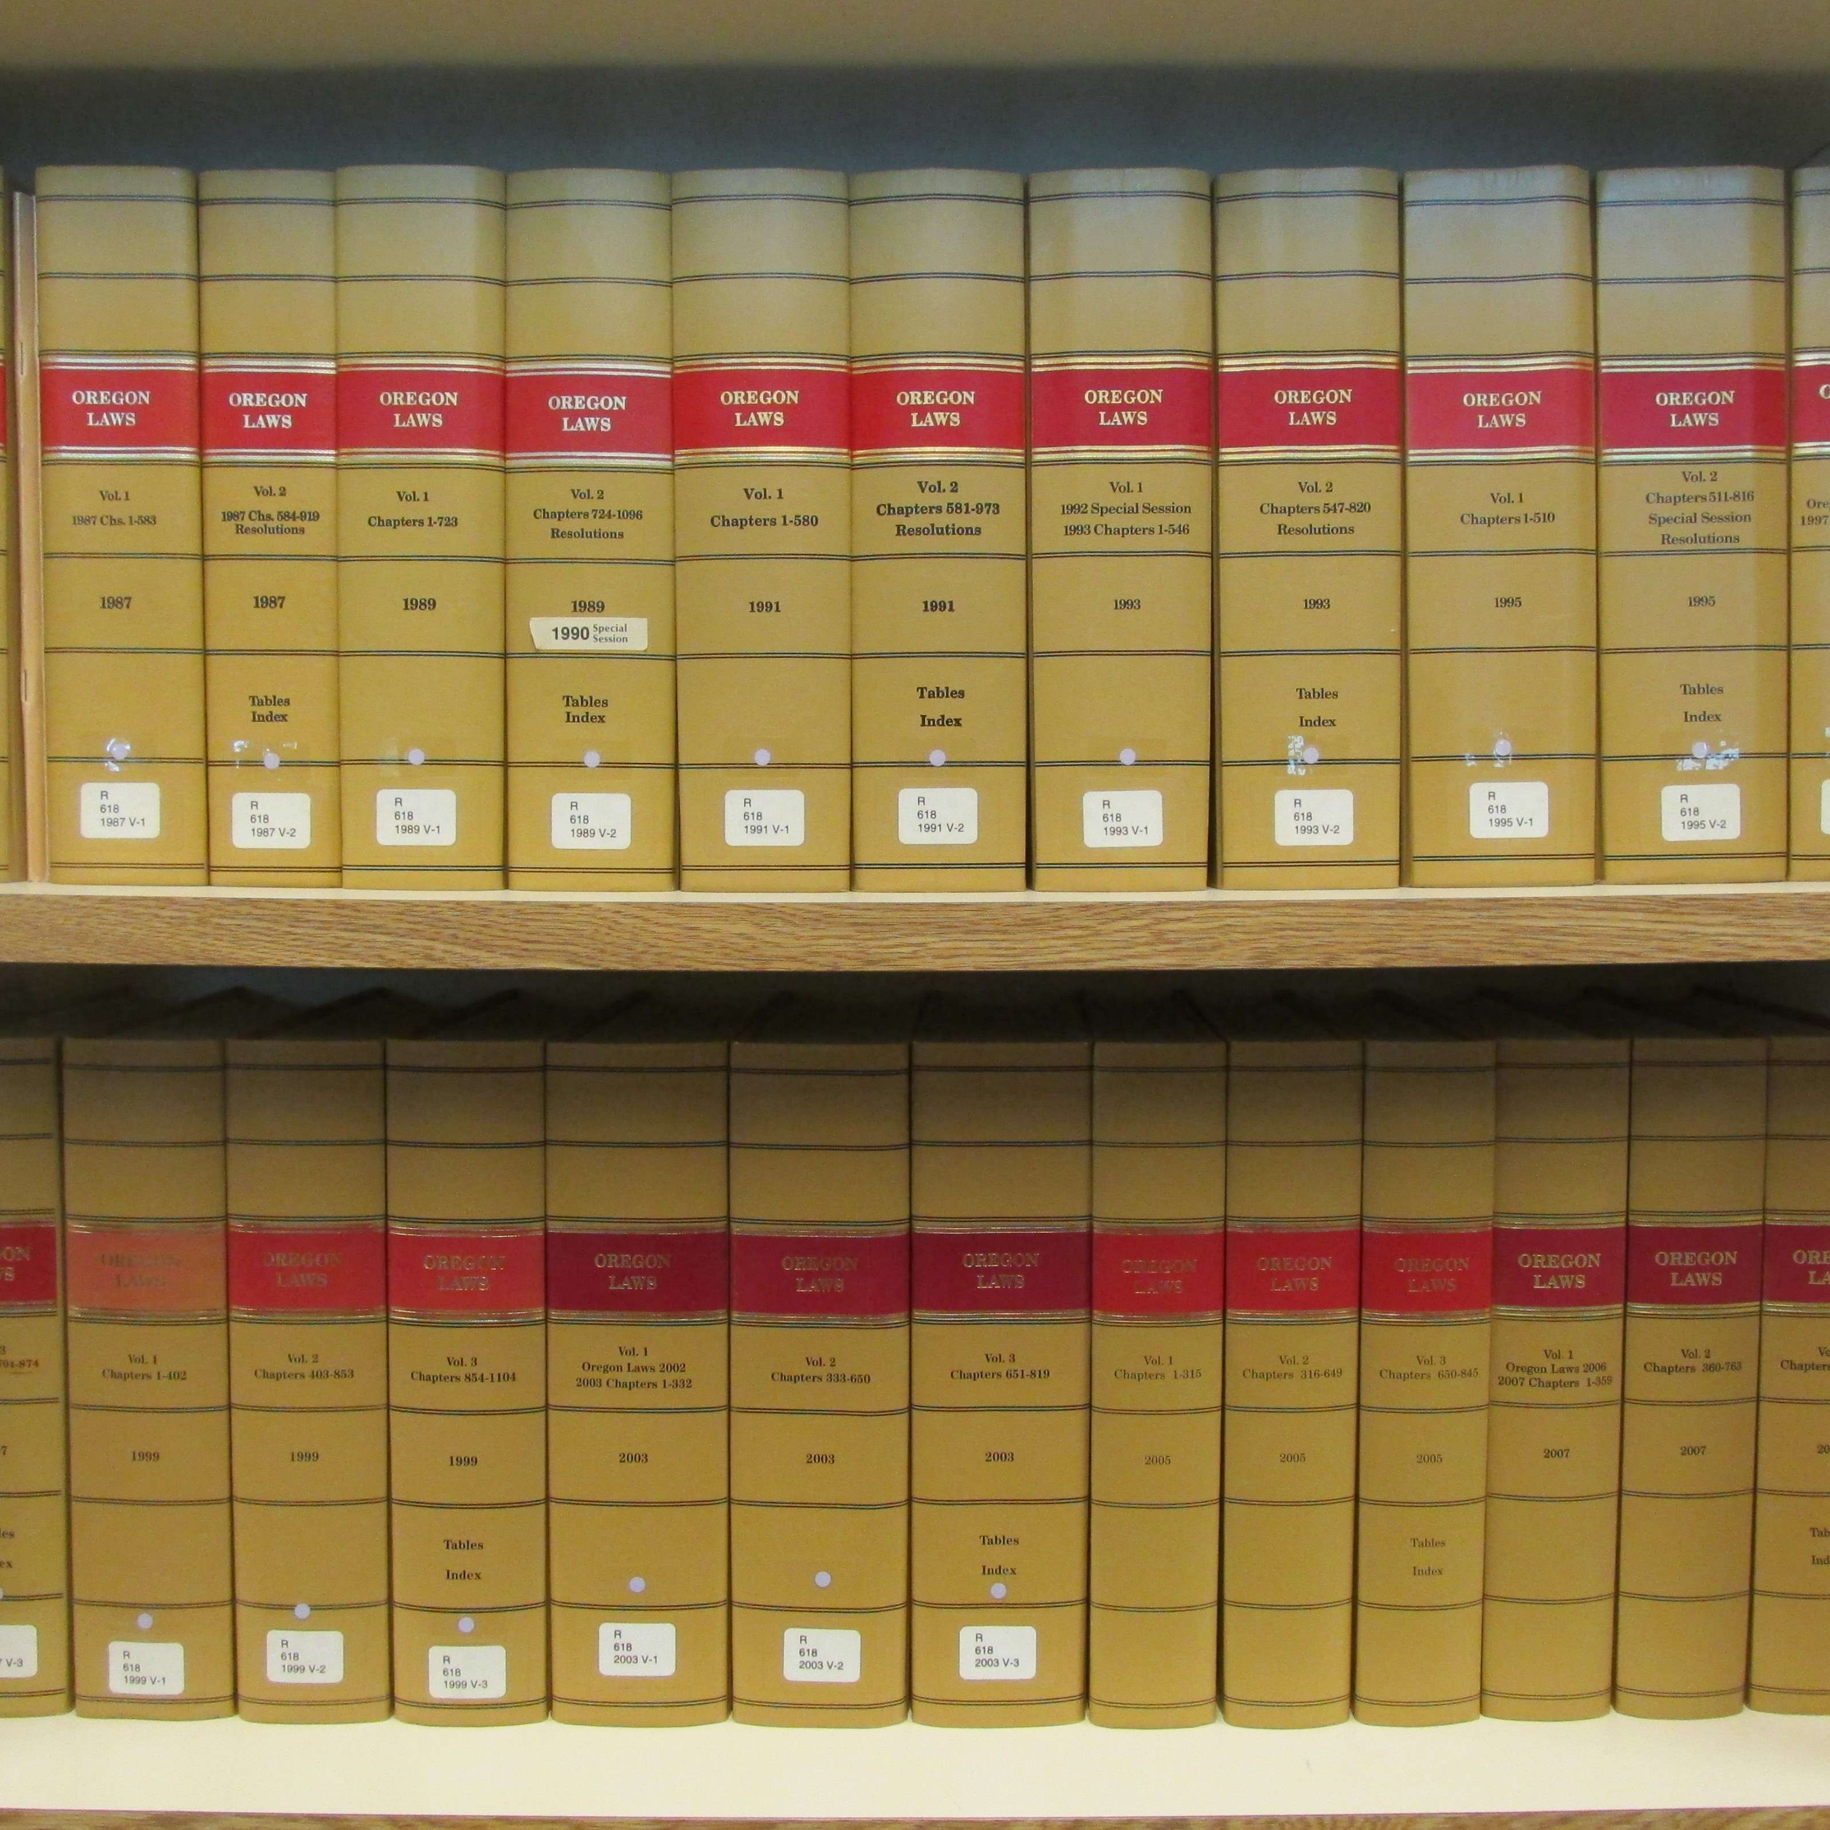
LAWS

Slide 38
LAWS
FEDERAL LAW (U.S.C.)
FEDERAL REGULATION (CFR)
U.S. SUPREME COURT
FEDERAL DISTRICT COURT
OREGON STATUTE (ORS)
OREGON RULES (OAR)
OREGON SUPREME COURT

Slide 39
LAWS
FEDERAL LAW (U.S.C.)
FEDERAL REGULATION (CFR)
U.S. SUPREME COURT
FEDERAL DISTRICT COURT
OREGON STATUTE (ORS)
OREGON RULES (OAR)
OREGON SUPREME COURT

Slide 40
LAWS
FEDERAL LAW (U.S.C.)
FEDERAL REGULATION (CFR)
U.S. SUPREME COURT
FEDERAL DISTRICT COURT
OREGON STATUTE (ORS)
OREGON RULES (OAR)
OREGON SUPREME COURT

Slide 41
LAWS
FEDERAL LAW (U.S.C.)
FEDERAL REGULATION (CFR)
U.S. SUPREME COURT
FEDERAL DISTRICT COURT
OREGON STATUTE (ORS)
OREGON RULES (OAR)
OREGON SUPREME COURT

Slide 42
LAWS
FEDERAL LAW (U.S.C.)
FEDERAL REGULATION (CFR)
U.S. SUPREME COURT
FEDERAL DISTRICT COURT
OREGON STATUTE (ORS)
OREGON RULES (OAR)
OREGON SUPREME COURT

Slide 43
LAWS
FEDERAL LAW (U.S.C.)
FEDERAL REGULATION (CFR)
U.S. SUPREME COURT
FEDERAL DISTRICT COURT
OREGON STATUTE (ORS)
OREGON RULES (OAR)
OREGON SUPREME COURT

Slide 44
LAWS
FEDERAL LAW (U.S.C.)
FEDERAL REGULATION (CFR)
U.S. SUPREME COURT
FEDERAL DISTRICT COURT
OREGON STATUTE (ORS)
OREGON RULES (OAR)
OREGON SUPREME COURT

Slide 45
OTHER REFERENCES
FIRE CODE
ATTORNEY GENERAL’S MANUAL
OPINIONS

Slide 46
OTHER REFERENCES
FIRE CODE
ATTORNEY GENERAL’S MANUAL
OPINIONS

Slide 47
OTHER REFERENCES
FIRE CODE
ATTORNEY GENERAL’S MANUAL
OPINIONS

Slide 48
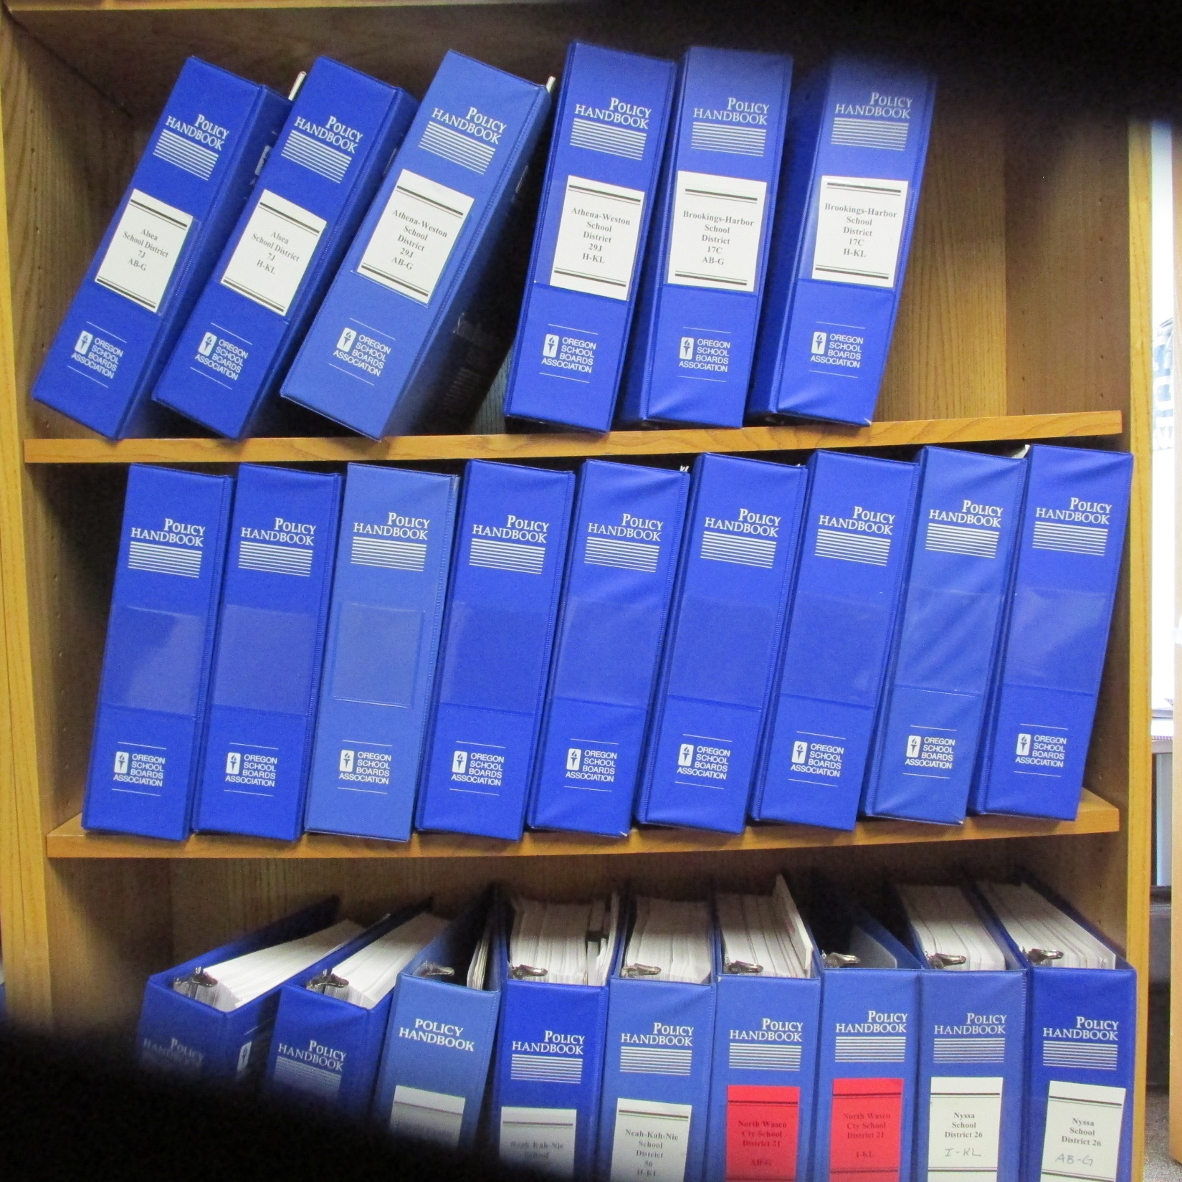
POLICY BFC

Slide 49
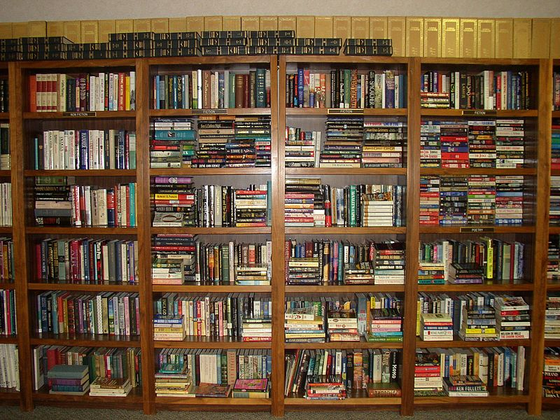
ORGANIZATION
Notes:
Public domain,

Slide 50
ORGANIZATION
AB
Board Governance
Notes:
Public domain,

Slide 51
ORGANIZATION
AB
C
Board Governance
Administration
Notes:
Public domain,

Slide 52
ORGANIZATION
AB
C
D
Board Governance
Administration
Fiscal Management
Notes:
Public domain,

Slide 53
ORGANIZATION
AB
C
D
E
Board Governance
Administration
Fiscal Management
Support Services
Notes:
Public domain,

Slide 54
ORGANIZATION
AB
C
D
E
F
Board Governance
Administration
Fiscal Management
Support Services
Facilities
Notes:
Public domain,

Slide 55
ORGANIZATION
AB
C
D
E
F
G
Board Governance
Administration
Fiscal Management
Support Services
Facilities
Personnel
Notes:
Public domain,

Slide 56
ORGANIZATION
AB
C
D
E
F
G
I
Board Governance
Administration
Fiscal Management
Support Services
Facilities
Personnel
Instruction
Notes:
Public domain,

Slide 57
ORGANIZATION
AB
C
D
E
F
G
I
J
Board Governance
Administration
Fiscal Management
Support Services
Facilities
Personnel
Instruction
Students
Notes:
Public domain,

Slide 58
ORGANIZATION
AB
C
D
E
F
G
I
J
KL
Board Governance
Administration
Fiscal Management
Support Services
Facilities
Personnel
Instruction
Students
Community Relations
Notes:
Public domain,

Slide 59
[BRACKETS]

Slide 60
within [five] working days

Slide 61
to the [superintendent]

Slide 62
the Board [may][shall]

Slide 63
Policy Update

Slide 65
Areas of Concern

Slide 66
Video Cameras
Who owns the data?
Public Record?
Student Record?
Personnel Record?
FERPA?
Parent Rights?

Slide 67
Student Conduct and Disciplinary Procedures
Policy EEACC and AR Required

Slide 68
Use of Activity Vehicles
Policy EEACD- Required
* Type 20- no home to school

Slide 69
Student Transportation Services
Policy EEA- Required

Slide 70
Private Vehicle for District Business
Policy EEBB- Highly Recommended

Slide 71
Student transportation in private vehicles
Policy EEBB- Highly Recommended

Slide 72
What have I missed? Questions

Slide 73
Peggy Holstedt, Director
pholstedt@osba.org
POLICY SERVICES
800-578-6722
Rick Stucky, Specialist
rstucky@osba.org
Leslie Fisher, Senior Assistant
lfisher@osba.org
SERVICES
La’Nell Trissel, Assistant
ltrissel@osba.org

Slide 74
PHOTO CREDITS
Police (Slide 3), Rama, https://creativecommons.org/licenses/by-sa/2.0/fr/legalcode, https://commons.wikimedia.org/wiki/File:Police-IMG_4105.jpg
Framing (Slide 10), Jaksmata, http://creativecommons.org/licenses/by-sa/3.0/legalcode, https://en.wikipedia.org/wiki/Framing_(construction)#/media/File:Wood-framed_house.jpg
Mimi (Slide 23), revelife.com, screen shot in folder
Domestic Violence (Slide 28), Denitza Tchacarova, http://creativecommons.org/licenses/by-sa/2.0/legalcode, https://en.wikipedia.org/wiki/Epidemiology_of_domestic_violence#/media/File:A_Russian_poster_urging_open_your_eyes_-_against_women_being_abused.jpg
Sunblock (Slide 32), Earthlydelights, https://creativecommons.org/licenses/by/2.0/legalcode, https://www.flickr.com/photos/earthlydelights/4424316944
Penguins (Slide 76), Brocken Inaglory, https://creativecommons.org/licenses/by-sa/3.0/legalcode, https://commons.wikimedia.org/wiki/File:Emperor(Aptenodytes_forsteri)_chick_with_parent_In_Ross_sea.jpg

