Slide 1
Records Management
For the 21st Century
Practical Approaches for Government
Stephanie Clark, CRM
Records Unit Manager
Oregon State Archives
Notes:
Here at the Archives Division, we have three distinct units –
Publications unit publishes the Oregon Administrative Rules, and the Blue Book, which is an almanac that takes a snapshot of Oregon government every 2 years.
The Reference unit accessions and provides access to Oregon’s permanent, historically valuable public records. You can come and use the Reference Room to view items from our collection or request records online. The collection is especially popular with genealogists, attorneys, and researchers of all kinds.
The third unit at the Archives is the Record Management Unit. We provide records management advice and assistance to all government entities from your largest state agency to your smallest sanitation district. We write retention schedules for all entities, including both general and special schedules. Our unit also manages the Security Microfilm Repository and the State Records Center, a warehouse where agencies can store non-permanent records. It’s a much less expensive alternative to a private records warehouse. The last function of our unit is the Oregon Records Management Solution, a project where we work with agencies to implement an electronic records management system.

Slide 2
What is public records management?
What do we have?
Where is it?
Who has it?
What format is it in?
How long do we keep it?
Answer as early as possible for ease of management later

Slide 3
Why worry about RM?
Poor RM is bad for the agency
Storage $, legal liability
Settling out of court often cheaper than defending
Poor RM is bad for employees
Can’t find what you need = time wasted
Tons of duplicate content, not sure what is “official”
Notes:
Before we get into the specifics of records law we find it helpful to frame the discussion a little bit. Why do we, as public employees, worry about records management? It’s not something that most people spend a great deal of time thinking about, and it is rarely the prime focus of most people’s jobs. Records management does, however, effect all of our abilities to do our work effectively, and has great importance for units of government to ensure the public trust and safeguard valuable information.
First of all, poor records management practices are can be harmful for agencies as a whole. Over-retaining records can involve growing storage and maintenance costs, not to mention costs associated with retrieving information when requested. Agencies also open themselves up to greater legal liability when they over-retain records, as they will be responsible to managing and providing access to those records for as long as they have them. Under-retaining records also presents a major risk to agencies, as failure to produce requested documents can lead to large fines or civil suits against the agency. Given these challenges many agencies choose to settle public records cases out of court for expediency’s sake, which is costly both in fiscal terms and in the eyes of the public.
Poor records management practices also have a negative effect on the employees of government agencies. Poorly organized information leads to employees spending far greater amounts of time searching for the information they need to do their jobs, or losing track of the information they need. This also contributes to lots of duplicate content being created, as people horde their own copies of needed records for easy retrieval. The result is that it can be almost impossible to identify what the “official” record is, or whether the version they have is in fact the most accurate or current. Records management practices effect everyone who works in public service.

Slide 8
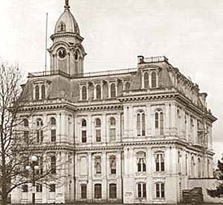
Know The Laws

Slide 9
Oregon Public Records Law
Retention & Disposition
“Public record” means any information that:
(A) Is prepared, owned, used or retained by a state agency or political subdivision;
(B) Relates to an activity, transaction or function of a state agency or political subdivision; and
(C) Is necessary to satisfy the fiscal, legal, administrative or historical policies, requirements or needs of the state agency or political subdivision. – ORS 192.005 (5)
Notes:
Let’s start with the laws. There are two sides to the public records law – the side under our jurisdiction speaks to retention and disposition. So, basically we can help you determine if something needs to be retained and if so, how long.
In order to be considered a public record for retention and disposition, a record needs to meet the three criteria listed here. When considering groups of records, ask yourself these three questions.
First, is it prepared, owned, used or retained by your program?
Does it relate to a specific activity, transaction, or function?
Is necessary to satisfy the fiscal, legal, administrative, or historical policies, requirements or needs of the agency?
This last part is the most crucial because it points out the fact that we don’t determine public records status based on the needs of outside entities. Just because someone wants a record, doesn’t mean an agency is required to retain it. Part C also outlines the four values that we look at when we write a retention schedule.
This other part of the public records law, I’ve added here to showcase the fact that the definition of a public record is not reliant upon format. So, the law is the law “without regard to the technology or medium.”
We will touch upon that more in future slides, as it has real life implications for how we are now creating government records.

Slide 10
Retention and Disposition
Each state agency or political subdivision shall maintain a public record or accurate copy of a public record in accordance with a retention schedule authorized under the law without regard to the technology or medium used to create or communicate the record.
- ORS 192.108

Slide 11
Access - The Basic Rule
“Every person has a right to inspect any public record of a public body in this state, except as otherwise expressly provided in ORS 192.501 to 192.505.”
- ORS 192.420(1)
Notes:
While the State Archivist has authority over retention and disposition of public records, the Department of Justice oversees the part of public records law relating to access to public records. It is important to note that information produced by a public entity may not be considered a “public record” for purposes of retention while still being considered public for disclosure purposes. The general rule regarding access to public records is shown on this slide. In short, agencies are required to present requested information when requested unless disclosure of that information is specifically exempted by law. There are many possible exemptions, but the burden is on the agency to justify any withholding of information. Questions regarding this aspect of the public records law should be directed to an agency’s legal counsel or their contact at DOJ, as there are many potential gray areas that the archives cannot rule on.

Slide 12
These Laws:
Apply to public work done anywhere: office, home, private devices or accounts all are subject.
DO NOT distinguish based on technology or format: content matters.
Notes:
All parts of Oregon’s Public Records Law apply to all public work, regardless of where it is done. There are innumerable examples of public employees landing in hot water from mismanaging public records on private devices or accounts, and you do not want to be another example. Public work is public work.
It is also important to note that the content of a record is what drives its retention and access requirements, not the format. A record has the same requirements whether it is an email, a paper document, or lives in a database. This is a concept that is key to managing modern electronic records.
It’s important that staff understands that if they are using a personal home computer to create public records, they could open themselves up to their personal property being seized for e-discovery purposes. There’s a case from a few years ago where a city councilor was composing records and saving them on the his home computer. When the records were requested, he had to turn over his personal computer. It’s best to have a policy in place internally so that staff knows that if they are creating public records using a personal account or device, they should figure out a way to save those records to a state controlled server.
The same goes for personal email accounts. Do not use your personal email to conduct public business. And keep your personal business out of your state issued email account.
We have seen examples of this such as the case of Nike vs. the city of Beaverton. The court ordered all records to be turned over including those that some of the councilors were storing on their personal laptops at home. For those who could sign an affidavit stating that they were not using their personal devices to conduct public business, personal home devices were not including in the discovery process. But one councilor in particular was not able to say that and had his personal computer seized. The computer contained drafts of annexation plans not previously disclosed. This was a turning point in the case and caused the city to settle out of court for almost a million dollars.

Slide 13
New(ish) Rules for Electronic Records
OAR 166 Div. 17 sets rules for:
Electronic Records Management Systems
Digitization of records
Retention of records in electronic format
File format standards
System security
System maintenance
Notes:
In 2016, we put out new standards to provide guidance for staff who is trying to manage their records electronically. The rules have been updated with modern language to address the use of electronic records management systems, digitization, file format standards, and sections on security and maintenance.
The formats we recommend are industry best practice standards, but are not recommended because we think they are “perfect” or “permanent” formats. The idea is that if an agency has a handle on what formats are in use, then if, say, the PDF is going to sunset, then the agency can put together a migration plan for the format.

Slide 14
Ensure Compliance
Have written policies and procedures that address use, access, retention & ownership of public records
staff trained on the policy
Have an authorized and up-to-date records retention schedule
Use the schedule systematically and routinely
Notes:
Have written policies and procedures that address use, access, retention & ownership of public records:
-Signed by staff
-Staff trained on the policy
Have an authorized and up-to-date records retention schedule, which Stephanie Clark, the manager of the Records Management Unit, can help with. So touch base with her to coordinate.
Use the schedule systematically and routinely

Slide 15
Records Retention Schedules

Slide 16
Records Retention - What is it?
How long a public record must be kept to satisfy administrative, legal, fiscal and historical requirements of that public record.
Determined by content of record, not format or medium
Records Retention Schedule
Lists ALL records & retention periods
Approved by the State Archives
Legal Authorization to destroy public records
Notes:
Your records retention schedule is your only legal authorization to destroy public records. The State Archivist is the only person who can authorize a retention schedule.
When we write a records retention schedule, we take into account the four categories of possible record value. Administrative, legal, fiscal, and historical.

Slide 18
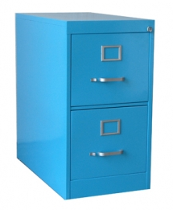
Filing Systems & Classifications Don’t just store: Manage
Notes:
Now that we have the legal framework for records management established it’s important to discuss how we actually go about handling the records in our care. What we all do currently is store records and other information. We are great at storing things, but storage is only a tiny part of records management. We need to look at how we are organizing our records so that we can work with them, provide access to them, and ultimately destroy them when the time comes.

Slide 19
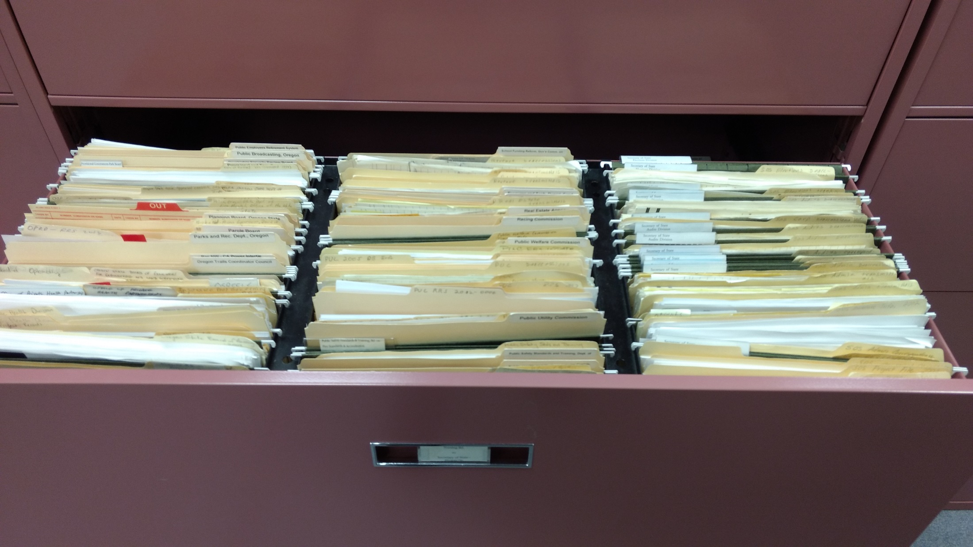
Traditional File Structure
Notes:
Here we have a typical office file cabinet. Each drawer may have one or more major subject areas which are further sorted by dividers and folders. Records are identified by labels and other notation, and sorted by a defined criteria – alphabetically, chronologically, etc. This is essentially how paper records have been filed for decades, and the basic structure is second nature to most people who work in office environments.
Now take this cabinet and replicate it electronically, with nested folders in a shared drive. The structure is simple enough, but things can go strange when we shift to the electronic world. Suddenly everyone has the ability to instantly create new folders or headings when they can’t find what they want. We no longer have gatekeepers who are experts in the file plan, and so rules get ignored. Over time training lapses and people forget what certain things mean. This gradual slide ultimately leads to…(slide change)

Slide 20
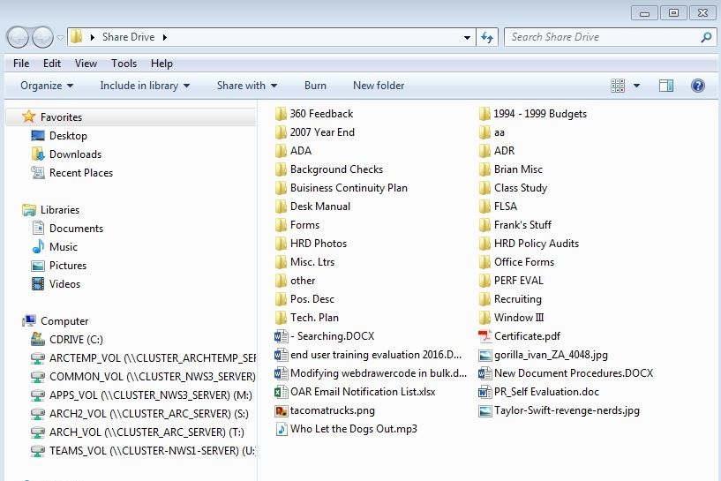
“Filing System”
Notes:
This. This is emblematic of every shared network drive that I have ever seen, and that’s not a condemnation of the people who work in them. The most carefully planned file structure will eventually break down without constant oversight and maintenance, and people are typically doing their regular jobs to be able to take time to tame the wild shared drive.
In this example you can see some folders that make sense given the previously established structure. There are folders for Forms, Background Checks and Recruiting, but there are also folders like “Brian Misc,” “Frank’s Stuff,” tons of acronyms and loads of loose documents where people have given up trying to find the right place. Most of these folders probably have a bunch of nested folders within them, adding to the complication. The only way to find something in a mess like this is if you know exactly where it is. Furthermore, there is likely lots of duplicate content present, since people tend to stash extra copies of records they use so they know where to find them. It’s impossible to proactively apply any sort of retention rules to this, since information isn’t organized in a way to make that possible. Everything has to be manual. Clearly, there has to be a better way.

Slide 21
Functional Filing Systems
Fewer categories for ease of use
Organize by broad functional areas
Group by retention requirements
Folders no longer just “forever” piles
Records all go into same areas- not personal folders
Notes:
So what have we learned from years of attempting to do old-style records management in the light speed electronic world? A few key lessons.
First, we have to simplify. Ask someone to sort things into 25 categories and they will look at you like you are crazy. Give them a dozen and they will do their best. Give them half that and it becomes an easy thing. In short, functional filing systems combine similar categories of records to lessen the burden on employees and make things easier to identify.
Next, we need to organize records my broad functional areas. Think departments, programs and the like. This is a bit of a carryover from traditional filing schemes, but it makes sense. Accounting personnel expect to have an accounting section, and so on.
Within those functional areas we do need to arrange records by retention requirements, however, or we will never be able to effectively manage the records for retention and disposition. If we intermingle records of different retentions the only way we have to purge them later is to look at each record. That’s not a viable strategy, so we create folders based upon retention periods of like records. We never want forever piles.
Finally, and perhaps most critically, official records need to all be filed in the same central areas, NOT in personal partitions or on local employee drives. The goal here is to control the records, and that means they need to be in once central location. Extra copies lying around will likely not be disposed of properly, which will lead to agencies over-retaining records. Personnel will also be sure that the copy of the record they are looking at is the official version if they are central, rather than relying on drafts and copies lying around elsewhere. Personal drives should be reserved for non-record materials, reference materials, unfinished drafts, scratch notes and the like.

Slide 22
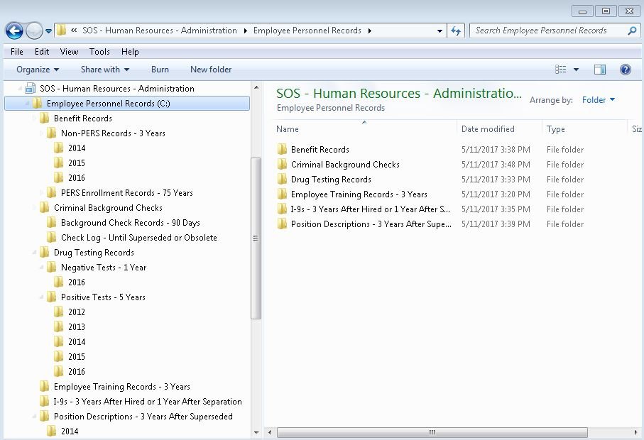
File Structure Revisited
Notes:
This slide shows what a filing system might look like if we followed the tips laid out on the previous slide. The top levels correspond to work functions, with folders below categorized by retention periods. The annual folders represent groups of records that can all be treated the same, and nobody has to manually look at each record to determine whether or not you can destroy them. This prevents ever-growing piles, and makes the job of managing them over time much easier. Less junk lying around means it is easier to find the records you need, and less liability related to public records requests.

Slide 23
Electronic
Records
Management Systems
Notes:
Once we’ve established our clean filing system, what’s to stop us from falling into bad habits again? A well organized training program and good unit-level understanding helps, but when things get busy practices tend to slip. Over time, we start to approach the same mess we had at the beginning. To avoid this we need to bring in new tools to automate simple routine decisions, lessening our reliance of every single person doing the correct thing 100% of the time. Enter the Electronic Records Management System.

Slide 24
Electronic Records Management System
Records created & received electronically
Records created & received in hard copy
Records are filed & managed for access, maintenance & destruction electronically
…more on that later!
Notes:
An electronic records management system can be used to locate and manage not just electronic records, but also physical record locations. For example, our Audits division uses our in-house electronic records management system to organize their audit reports. They can drag and drop electronic copies of the reports into the system, file email, and other research documents. They can also enter in locations for where boxes are physically stored. So, if they search by an agency name they will see: the report, the back up documents, and a little marker that tells them where to look for the box in the box storage area. All with one search, in one system.

Slide 25
Why ERMS?
Manual RM doesn’t work in electronic world
Too much stuff
No physical reminders
Copies abound, not much administration
Security a big concern
PR requests & e-discovery = time and $
Files need monitoring to ensure ongoing access
Notes:
- So why is an ERMS such a valuable tool? Why can’t we go the “cheap” route and simply have people do their jobs like always? There are a number of reasons why manual RM doesn’t work in the electronic world, and there is loads of evidence to back them up.
- First, there is simply too much stuff these days for people to stay on top of. We create mountains of digital information on a daily basis, and even were everyone to dedicate half their time to managing it we still wouldn’t get to it all.
- To go along with this huge volume there are no physical reminders that spur us into action. As physical beings we respond pretty well to piles of papers sitting on our desk- they are there every day reminding us to do something. That same pile of papers in digital form? A neat little folder that can be happily ignored forever.
- We also create massive numbers of duplicate copies of electronic information, most of it uncontrolled. Think about every time you collaboratively work on a document with a group of people. Do you email copies back and forth? How many versions might there be? So now, instead of one document we might have dozens we have to manage. It’s almost impossible to reliably destroy all the copies when it is time, and controlling access is similarly difficult.
- Security also gets exponentially harder when you have to apply rules to so many different silos. Lapses are almost inevitable, in which case your agency could be at tremendous risk.
- Without centralized control of your information it becomes much harder to find and produce it as well when facing public records requests or e-discovery requests. Time spent, lawyer fees, all add up.
- Finally, electronic records need monitoring over time to ensure they remain accessible. File formats change, and what is best today may not be in 15 years from now. We need to understand what we hold to be able to better prepare for the future, and an ERMS allows us to track all of our information.

Slide 26
ERMS Benefits
Government Efficiency
Dramatic improvements in response time for public records and e-discovery requests = public happier
less unnecessary redundancy
Regular and orderly destruction of records
Transparency & Accountability
Security & rules consistently applied
Audit trails for full life of records
Notes:
Having framed the problem, let’s discuss specific benefits you can derive from an ERMS. First, government agencies can see tremendous efficiency gains through the use of these tools.
-ERMS’ allow you to manage both electronic information and paper information in the same place. While the paper records don’t actually live in the system, you can create markers, virtual records if you will, that can be managed for retention and disposition with their electronic counterparts. When it comes time to destroy them agencies have a reminder to also check certain file cabinets or off-site storage.
-Similarly, one can search in one place for all of your information, cutting down on redundant effort and dramatically reducing retrieval time. This leads to faster PR request compliance and a happier public.
-Using an ERMS also cuts down on huge amounts of redundancies, which frees up IT resources for other, more proactive projects. Instead of creating dozens of email drafts before finalizing a document, one can manage them from the start in one central location.

Slide 27
ERMS Options
Agency standalone system
Must be DoD 5015.2-STD certified,
Different software options, but look closely: Document Management DOES NOT equal Records Management
Statewide system
57 state & local agencies implementing
Uses HPE Records Manager software
Agencies pay per user, no hardware or software costs
Support provided by State Archives & Chaves Consulting
Notes:
So what options do government agencies in Oregon have regarding ERMS’?
Agencies are able to select their own system providing it meets all requirements in OAR 166 Div. 17. Of particular note is that any ERMS selected by an agency must be certified to meet the Department of Defense’s 5015.2-STD standard for electronic recordkeeping systems. This standard ensures the security and interoperability of data stored within compliant systems, meaning government data is protected and is available to those that need it. Software that is not DoD 5015.2 certified is not approved for the permanent storage of government records.
Agencies must also be on the lookout when seeking recordkeeping systems, as there are many products out there that may appear to be ERMS’ but in fact are Electronic Document Management Systems. EDMS’ have many of the same features of ERMS’, and are often cheaper, but lack critical retention and disposition components that allow agencies to efficiently practice records management. It is very important that agencies understand this distinction when speaking with vendors so they are looking at the correct product.
Agencies in Oregon also have the unique opportunity to join our statewide electronic records management system, called the Oregon Records Management Solution, or ORMS. This project is a public-private partnership facilitated by the State Archives and Chaves Consulting. ORMS works in the “software as a service” model, where agencies pay a monthly subscription fee and then are able to implement an ERMS without all of the significant infrastructure costs associated with doing so alone. They also get the benefit of archives’ staff directly helping them organize and manage their records proactively. Currently more than 40 state and local government agencies are members of ORMS, ranging from small special districts to school districts, courts and state agencies.

Slide 28
Modern Communications New Technology, Same Records

Slide 29
The Problem with Email
Exploding Volume
IT policies often control deletion
Lots of potential public records
Attached documents may be records as well
How to schedule?
Existing retention schedules apply
Content of record, not format, important
BUT difficult to sort & handle in a practical way

Slide 30
A Practical Approach to Email
Two lessons learned:
Less sorting = greater compliance
Email content can be predicted
How should I retain emails?
Routine business correspondence: based on position
What records do you touch?
What is the longest retention in the schedule?
Projects, Case files, Contracts: There’s a folder for that!

Slide 31
Tips for Email Management
Know what NOT to keep
FYIs, CCs, informational notices
ads, listserv messages, event announcements,
Personal correspondence
Articles, reference materials
Know who is responsible:
Internal email: Sender
Email from outside source: Recipient

Slide 32
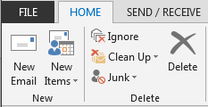
More Email Tips
Purge “Deleted Items” folder regularly
Make useful, specific subject lines
Helps for ID, search, retrieval
Keep only last message in a string
Use Outlook Clean Up Tool
Notes:
In most cases, if an email is internal with other state employees, it’s the sender who is responsible for retaining the record copy. If it’s an email from a constituent or an outside source, then it would be your obligation to retain that for the duration specified in the schedule.
Does anyone use Outlook for their email? We are huge proponents of the Clean Up Tool in Outlook. What it does is it takes a conversation and condenses it to the last piece of the thread. Meaning it removes all of those extra copies of that conversation back and forth. It does save iterations that contain a side conversation, a forward, or an attachment. So any unique content is captured. The State Archivist approves of the use of this tool.

Slide 33
Social Media and Mobile Tech
New Technology, Same Records

Slide 34
Social Media
SM content CAN be a Public Record
Is it used to conduct agency business?
Is the content unique?
Need to have written policies & procedures
Must address Use, Access, Retention and Ownership
Plan for capturing content
Built-in mechanisms (Twitter)
Capture with software
Compose and control locally

Slide 35
Text Messages & Messaging Apps
Controlled by provider
Can be records
Good policy is necessary
Recommend against using for “big” convos
“Substantive business-related discussions are not to take place via SMS or other mobile messaging apps”
Must capture records that occur
Forward to govt. email
Mobile Device Management

Slide 36
Other Office Communications
VOIP phone systems
Normal voice conversations not a record
VM left on phone is ephemeral
IF a recording is made and transmitted outside the phone system must be treated as any other potential record
Instant Messaging services (Slack, Spark, Skype)
Used for same purpose as email, has exact same value
Must plan for capture and retention as appropriate

Slide 37
New Frontiers
Snapchat
Body Cams
Drones
Notes:
-use example of Metro, where the same drone is being used by different entities- some may be law enforcement, some may be roads, some PR, etc. Need to differentiate when footage is generated.
What’s the purpose of the recording?
Is it being used as evidence for current or pending investigation?
Same baseline retentions as other similar listed items in schedule
Plan for storage needs

Slide 38
QUESTIONS?
Stephanie Clark
Manager, Records Management Unit
503-378-8161
stephanie.clark@oregon.gov

