Slide 1


America’s Professional School Bus Drivers:
Their Importance, Qualifications, and Performance
51st OPTA Summer Conference
Charlie Hood, Executive Director, NASDPTS

Slide 2
What this workshop is NOT:
Not about bashing school bus drivers
Not about how to recruit and retain sufficient drivers (unfortunately)
Not about recommending new federal mandates (OK, maybe one or two)
Absolutely NOT about suggesting that school buses are unsafe
Not about buying into alarmist media narratives

Slide 3
What we WILL discuss:
The importance of school bus drivers to:
  Student safety (as pedestrians and riders)
  Parents’ needs and convenience
  Ensuring equitable access for all students to public education programs, options, and activities
The complexity and difficulty of the professional school bus driving job (not just maneuvering buses)
Recent damaging media reports about a small percentage of what I call “drivers behaving badly”

Slide 4
What we WILL discuss:
A very brief history of regulations and guidelines
Requirements, recommendations, and best practices for:
  School bus driver licensing
  School bus driver training
  School driver qualifications
  School bus driver performance monitoring and enforcement
The new NASDPTS Position Paper (and why we developed it)
The NTSB’s Special Investigation Report on the November 2016 Baltimore and Chattanooga school bus crashes

Slide 5
Defining our terms
Federal requirements (nationwide laws and regulations)
State requirements (especially need your input on Oregon’s)
Local school district requirements (policies)
Local school district procedures (operational requirements)
Contractors’ requirements???
Guidelines (written recommendations)
Best Practices (industry consensus, such as NCST)

Slide 6
CBS News and Good Morning Show (June 2017)

Slide 7


Slide 8
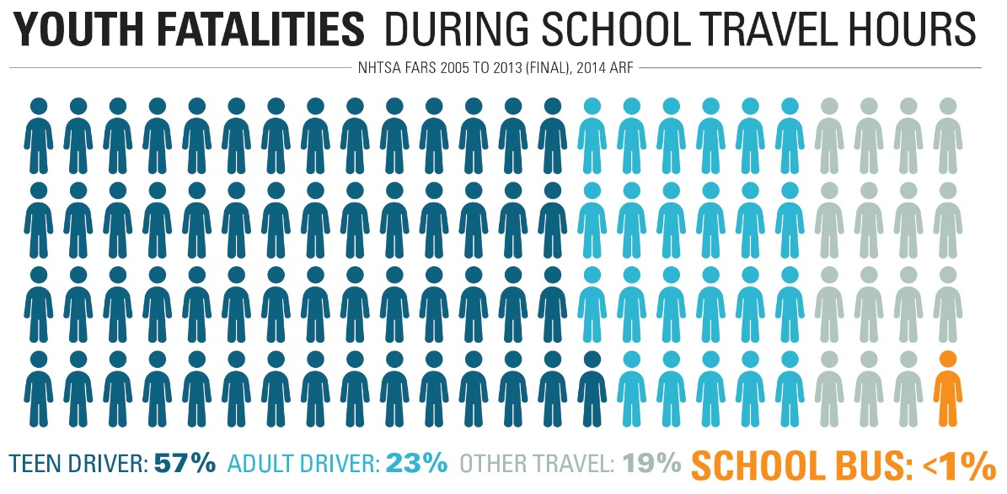
Safety of School Buses
Yellow school bus transportation remains far safer than other modes
For example, less than one percent of youth fatalities during school travel hours are in school buses, versus 57 percent when riding with teen drivers and 23 percent with adult drivers (www.schoolbusfacts.com)

Slide 9
Importance of drivers to parents:
From American School Bus Council (ASBC) Research Project, “Expanding Yellow School Bus Ridership”:
  Social interaction opportunity and convenience emerged as the most important benefits of ridership. Parents value the social opportunity the bus offers to their children, primarily because kids can enjoy time with their friends, but also as a chance to learn how to handle various personalities. Parents also value the convenience school buses provided them, e.g. to save time and provide efficient, easy access to schools.

Slide 10
What’s so tough about driving a bus?:
The term, “school bus driver” itself is insufficient.
School bus drivers must know laws, rules, and be proficient in:
  Safely maneuvering a 40 foot vehicle;
  Managing students in a firm, consistent, yet friendly manner;
  Recognizing, intervening, and reporting signs of sexual harassment, bullying, or abuse;
  Communicating effectively with parents, co-workers, and administrators;
  Performing pre- and post-trip inspections of the school bus;
  Learning and effectively operating new and ever-improving equipment and technologies on the bus;

Slide 11
What’s so tough about driving a bus?:
School bus drivers must know laws, rules, and be proficient in:
  Dealing with confidential student information in a legally compliant and responsible manner;
  Avoiding distractions;
  Dealing with road and weather hazards;
  Dealing with student medical issues;
  Adapting to changes in routes and stops;
  Being knowledgeable of individual students’ needs, especially those of students with disabilities, while ensuring confidentiality;
  Knowing federal, state, and local laws;
  And on and on…

Slide 17
America’s nearly one-half million school bus drivers do a remarkable job each and every day of keeping children safe, often with little respect or understanding by the public and for minimal pay. Unfortunately, even a few “drivers behaving badly” are unacceptable. We are in a business that demands zero tolerance for defects.

Slide 18
Our successful history:
For much of our nearly 100 year history, unlike other modes, school bus vehicle and driver safety have been largely self regulated.
Since the early 1920's when training manuals for school bus drivers were developed, private and public entities have continued their efforts to develop and improve school bus driver training.
In 1939, education and transportation professionals convened the first National Conference (now “Congress”) on School Transportation (NCST). The NCST, held most recently in 2015 for the sixteenth time, provides a forum for delegates from nearly all states to deliberate and adopt standards, specifications and procedures in all aspects of student transportation. The resulting document, now known as the National School Transportation Specifications and Procedures, is advisory and represents the national consensus among student transportation professionals regarding a broad range of topics, including recommendations for what school bus drivers should know and do.

Slide 19
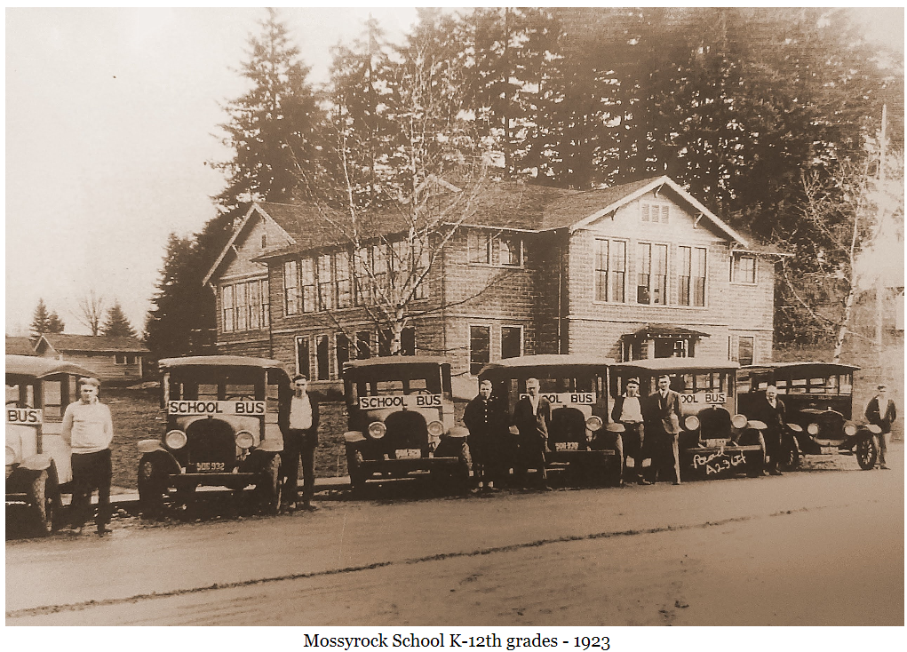

Slide 20
Our successful history:
In 1974 Congress mandated that NHTSA develop what became the April , 1977 and later Federal Motor Vehicle Safety Standards.
In 1991 Congress passed the Omnibus Transportation Employees Testing Act requiring drug and alcohol testing of all commercial drivers.
In 1992 the CDL program was implemented.

Slide 21
So how do we deal with bad actors and mitigate real or perceived damage?
NASDPTS decided the first step was to outline:
  The existing safety record of school bus drivers
  Why professional school bus driving is important
  What national requirements already exist
  What state and local requirements are common, but not universal (for example, criminal background checks)
  What basic requirements for licensure, training, qualifications, and performance should every school bus driver have to meet (including contracted, private school, and charter school drivers)
  What should school districts and other hiring entities should be doing to prevent or stop instances of non-compliance

Slide 22
May 2018 NASDPTS Position Paper
Available at: http://www.nasdpts.org/Operations/Drivers.html

Slide 23
Areas outlined in position paper:
Commercial Driver Licensing (CDL)- federal, but implemented by states
Pre-service Training- state and local, but to include new federal rules starting 2020 entry for level driver training (ELDT) of all new applicants
In-service Training- state and local
Criminal Background Checks- state and local
Drug and Alcohol Testing- federal; consequences mostly local
Medical Fitness- state and local; often similar to federal rules
Driving History Record- some federal; mostly state and local
Pre- and Post-trip Inspections by Drivers- state and local

Slide 24
Next steps by all who regulate, employ, or supervise school bus drivers:
From the NASDPTS position paper, “Our hope is that safety partners at all levels, including federal and state agencies, school districts, private schools, charter schools, and contractors, see these incidents as red flags that warrant a top-to-bottom review of laws, regulations, practices, and procedures for school bus driver hiring, monitoring, and retention. Policies are only effective when they are consistently followed and enforced. In the unfortunate event that any alleged or proven illegal action by a school bus driver occurs, it must be investigated thoroughly, and legally authorized consequences must be imposed.”

Slide 25
Next steps by NASDPTS:
Perform a follow-up survey of state directors to inventory what laws and regulations states have in the specific areas of school bus driver licensure, training, qualifications, and performance that are outlined in the NASDPTS position paper.
Analyze the survey results to identify gaps in meeting the requirements and recommendations and inform members.
Respond to the NTSB Safety Recommendations contained in the Baltimore/Chattanooga report
Consider identifying and incorporating updates to the NASDPTS position paper that may arise from the NTSB report or other sources.
Submit position paper for consideration by 2020 NCST delegates.

Slide 26
Drivers are everyday heroes!

Slide 28
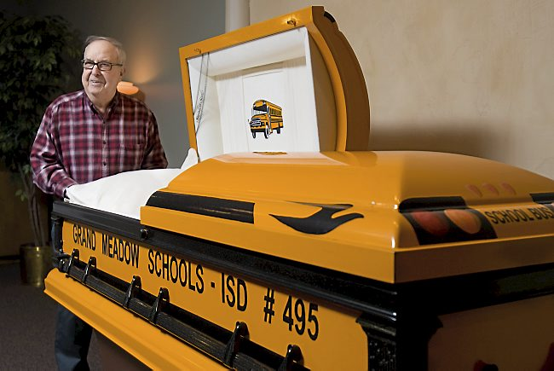
Dedicated, even in perpetuity!

Slide 29
Questions?
Comments?
My contact information:
Charlie Hood, Executive Director, NASDPTS
ExecDir@nasdpts.org
(850) 274-4308

Slide 30


