Slide 1

NASDPTS Illegal Passing Survey: Documenting the Problem and Finding Solutions
Charlie Hood, Executive Director, NASDPTS
51st OPTA
June 22, 2018
(Note: Additional joint presentation materials are also available from Derek Graham, former NC State Director)

Slide 2
Anderson County, SC, Distracted Driving Video (May 2018)

Slide 3
Montgomery County Schools (MD), Passing Safety Awareness Video (2017)

Slide 4
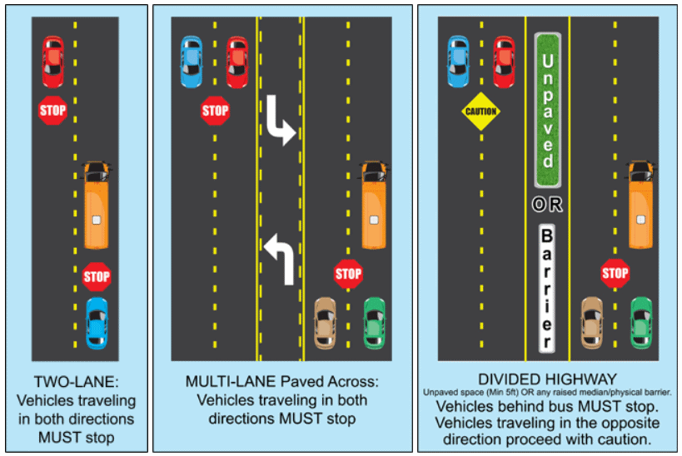
Illegal Passing—the Big Picture
How prevalent is illegal passing, really? (short answer: VERY)
Why is reducing illegal passing a priority?
What are the contributing causes?
What are the safety countermeasures? What are innovative states and LEAs doing about it?
Who are the safety partners?
How can we move toward ZERO?

Slide 5
Quantifying the Obvious
In 2010 NASDPTS conferees adopted a resolution establishing the first Stop Arm Violation Survey
Goal was to quantify anecdotal evidence that motorists were frequently passing stopped school buses illegally
National survey was to expand on prior state surveys (e.g., Florida and North Carolina)
States instructed to have drivers report illegal passing incidents during a one-day “snapshot” in the spring
NASDPTS established the standard reporting form and procedures
Data collected was intentionally minimal--drivers were cautioned that attention to safety of students during loading and unloading was first priority

Slide 6

NASDPTS Illegal Passing Survey
One-day snapshot captured by school bus drivers
Completed annually since 2011 to document incidence of other vehicles illegally passing their buses
2018 survey results:
  106K school bus drivers in 38 states, plus DC
  84K motorists illegally passed their buses
  Equates to over 15M violations per year nationally
Complete results will be available at http://www.nasdpts.org/StopArm/index.html

Slide 7
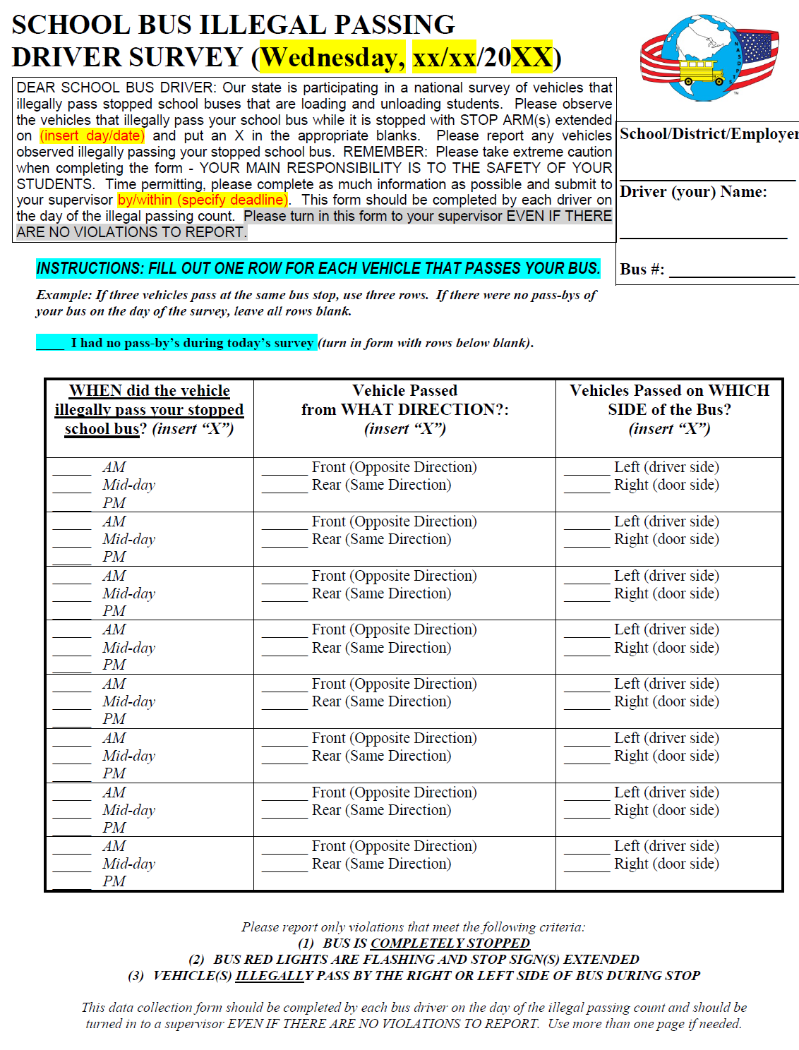

Slide 8
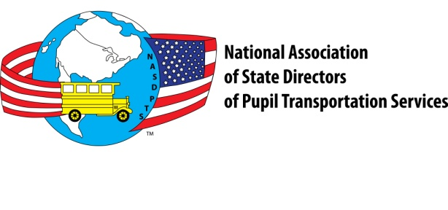
Multi-year Summary

Slide 10
Oregon’s 2018 Results
2,704 School Bus Drivers Participated
1,985 Total Pass-by’s
918 AM Illegal Passes
81 Mid-day Illegal Passes
986 PM Illegal Passes
1,705 Illegal Passes from Front (opposing bus)
276 Illegal Passes from Rear (same direction)
1,936 Illegal Passes on Left Side
45 Illegal Passes on Right Side

Slide 11
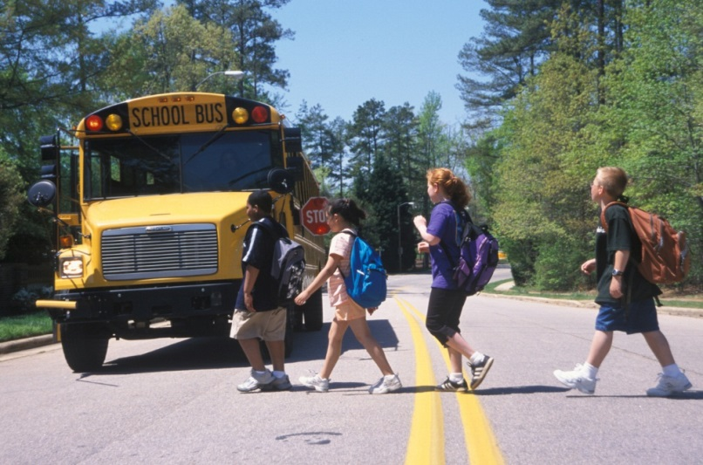
Survey Takeaways
Results unfortunately consistent over eight years
About 20 percent of the nation’s school bus drivers participate
Six more states this year than in highest previous
AM and PM passes close to equal
About 59% of passes from front, 41% from rear
Much higher % from front in Oregon (86% in 2018)
Equates to over 15M per year
2.1% are on right side!

Slide 12
Right Side – Washington State

Slide 13
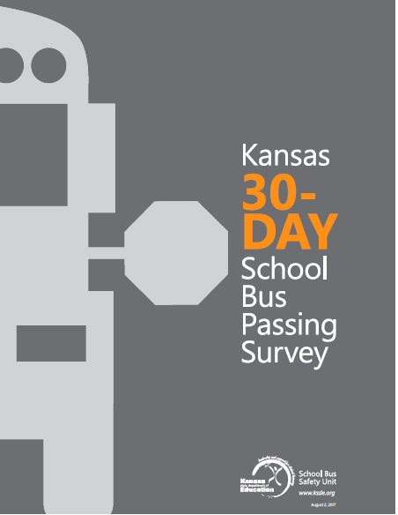

Slide 14

Student Loading Zone Fatalities
Kansas has conducted annual surveys of all states since 1970
During recent six years (FY2011 through FY 2016), nationally:
  Average of five students per year killed by vehicle illegally passing school bus
  Average of three students per year killed by own bus
  http://www.ksde.org/Agency/Fiscal-and-Administrative-Services/School-Finance/School-Bus-Safety/Loading-and-Unloading-Surveys

Slide 15
Kansas Survey 45-year Trends
65% of fatalities PM; 32% AM
66% of fatalities were children 8 years old or younger
Most fatalities in daylight, clear weather
No significant difference in boys vs. girls killed
No significant difference in day of week (M-F)

Slide 16
Survey of State Laws
In 2013 NASDPTS conducted survey on state laws requiring motorists to stop for school buses
37 states responded
All states required motorists to stop from both directions on two lane roads
For roads of 3 or more lanes, all required motorists to stop when approaching from rear
Most states allow motorists opposing bus to proceed if there is an unpaved median
In 26 states law enforcement MUST witness violation to secure a criminal penalty
17 states allowed photo/video evidence
Significant variations in laws, consequences

Slide 17
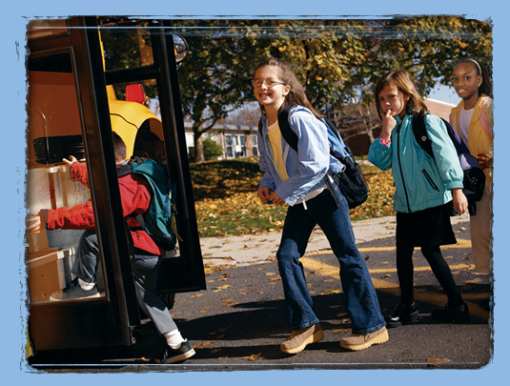
Loading Zone Safety
Yellow school bus transportation remains far safer than other modes
For example, less than one percent of youth fatalities during school travel hours are in school buses, versus 57 percent when riding with teen drivers and 23 percent with adult drivers (www.schoolbusfacts.com)
Loading zone safety remains our priority
Required safety countermeasures are a complex mix of laws, policies, and best practices that include…

Slide 18
Safety Countermeasures
Prevention of stop arm violations through public awareness
Frequent, visible enforcement and convictions
Student rider training
School bus driver training in crossing and student signaling procedures
Vehicle factors (mirrors, high visibility lighting, pupil crossing arms, conspicuity)
School bus stop placement
State laws and penalties for violations

Slide 19
Northhampton, MA, Passing Safety Awareness Video

Slide 20
Safety Countermeasures
Documenting the problem:
  Illegal passing surveys
  Identification of high violation areas
  Video or photo recording of violations
  Notification of high violation areas to public and law enforcement
Public awareness efforts:
  State law on required motorist actions when encountering buses slowing or stopped
  Back to school safety messaging
  Discussion of consequences (not just civil or criminal penalties)

Slide 21
Safety Countermeasures
Enforcement:
  Ongoing relationship with local and state police
  Training and awareness for prosecutors and judiciary
  Priority on most vulnerable locations
  Ongoing enforcement and enforcement blitzes
  Police presence emphasis during back to school, Safety Week, Love the Bus
  Citations from photo or video evidence (if legal)
  Longitudinal tracking of enforcement frequency
Student rider training on bus stop waiting location, potential hazards, crossing procedures
Driver training in stopping sequence, student crossing, and student signaling procedures

Slide 22
Gaps and Data Needs
National data is needed on:
  State laws re: stopping for buses
  State and local enforcement levels
  Related student injuries
  State regs and training of drivers and students (e.g., crossing procedures)
  Effectiveness of countermeasures (e.g., photo/video enforcement)
  Further analysis of Kansas and/or FARS data

Slide 23
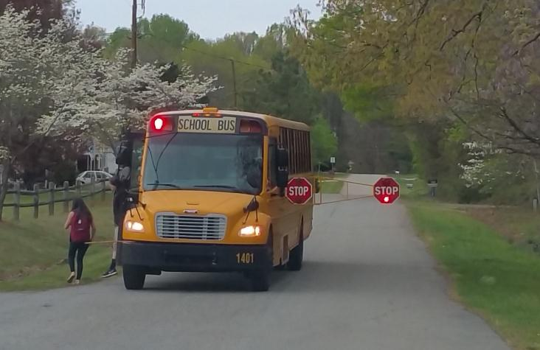
Model Policies, Best Practices
  For discussion, is there need for?:
    Model state law re: stopping for buses
    National priority on illegal passing enforcement (e.g., targeted grants)
    Model training curricula for school bus drivers and student riders
    Model state law on photo/video enforcement
    Promoting loading safety-related vehicle specifications and operational procedures of National Congress on School Transportation (ncstonline.org)

Slide 24
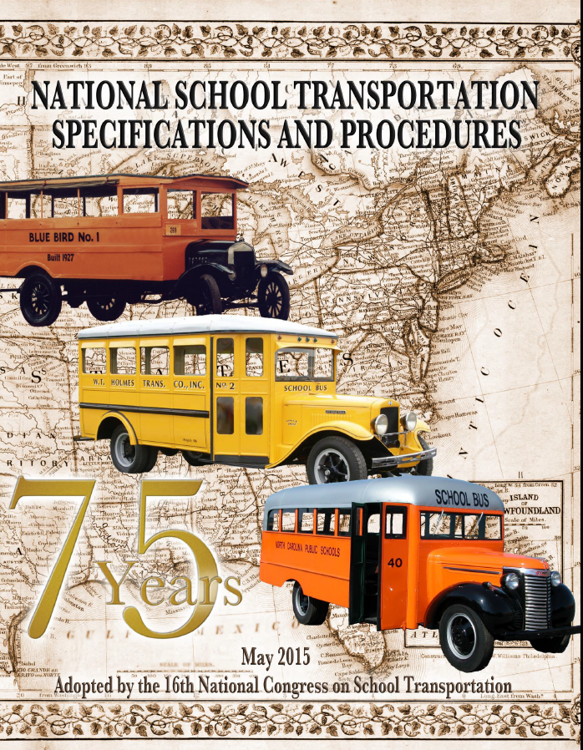

Slide 25
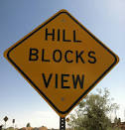
Contact Info
ExecDir@nasdpts.org (Charlie Hood)
850-274-4308
www.nasdpts.org

